Slide 1
File Management
By
Maj Dr Asif Masood

Slide 2
File Management
File system provides a means of storing data in an organized manner
File management system consists of system utility programs that run as privileged applications
Input to applications is by means of a file
Output is saved in a file for long-term storage

Slide 3
File System Properties
Long-term existence
Stored on disk and does not disappear
Sharable between processes
Structure
Can have an internal structure that is convenient for specific applications
Files may be organized into hierarchical structure

Slide 4
File Operations (functions that can be performed on files)
Create
Delete
Open
Close
Read
Write

Slide 5
File Structure
Field
Basic element of data
Contains a single value
Characterized by its length and data type
Record
Collection of related fields
Treated as a unit
Example: employee record

Slide 6
File Structure
File
Collection of similar records
Treated as a single entity
Have file names
May restrict access
Database
Collection of related data
Relationships exist among elements

Slide 7
Typical Operations
Retrieve_All
Retrieve_One
Retrieve_Next
Retrieve_Previous
Insert_One
Delete_One
Update_One
Retrieve_Few

Slide 8
File Management Systems
Set of system software that provides services to users and applications in the use of files
Typically, User or application access files through file management system
Relieves user of the necessity of developing special purpose software for each application

Slide 9
Objectives for a File Management System
Meet the data management needs and requirements of the user
Guarantee that the data in the file are valid
Optimize performance
Provide I/O support for a variety of storage device types
Minimize or eliminate the potential for lost or destroyed data

Slide 10
Objectives for a File Management System
Provide a standardized set of I/O interface routines
Provide I/O support for multiple users

Slide 11
Minimal Set of Requirements
Each user should be able to create, delete, read, write and modify files
Each user may have controlled access to other users’ files
Each user may control what type of accesses are allowed to the users’ files
Each user should be able to restructure the user’s files in a form appropriate to the problem

Slide 12
Minimal Set of Requirements
Each user should be able to move data between files
Each user should be able to back up and recover the user’s files in case of damage
Each user should be able to access the user’s files by using symbolic names

Slide 13
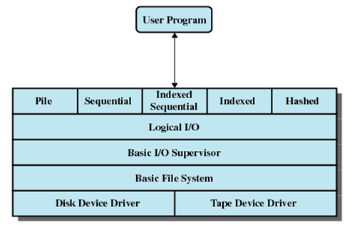
Device Drivers
Lowest level
Communicates directly with peripheral devices
Responsible for starting I/O operations on a device
Processes the completion of an I/O request

Slide 14
Basic File System
Physical I/O
Deals with exchanging blocks of data
Concerned with the placement of blocks
Concerned with buffering blocks in main memory

Slide 15
Basic I/O Supervisor
Responsible for file I/O initiation and termination
Control structures are maintained
Concerned with selection of the device on which file I/O is to be performed
Concerned with scheduling access to optimize performance
Part of the operating system

Slide 16
Logical I/O
Enables users and applications to access records
Provides general-purpose record I/O capability
Maintains basic data about file

Slide 17
Access Methods
Interface between the application and file system
Reflect different file structures
Different ways to access and process data

Slide 18
Criteria for File Organization
Short access time
Ease of update
Economy of storage
Simple maintenance
Reliability

Slide 19
File Organization
Pile
Sequential file
Indexed sequential file
Indexed file
Direct or hashed file

Slide 20
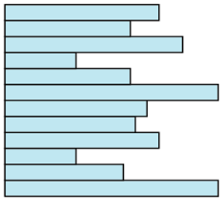
Pile
Data are collected in the order they arrive
Purpose is to accumulate a mass of data and save it
Records may have different fields
No structure
Record access is by exhaustive search
Used when data is not easy to organized
Unsuitable for most applications

Slide 21
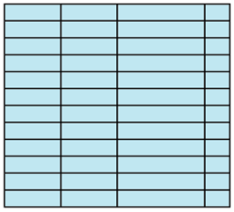
Sequential File
Fixed format used for records
Records are the same length
All fields the same (order and length)
Field names and lengths are attributes of the file
First field is the key field
Uniquely identifies the record
Records are stored in key sequence

Slide 22
Sequential File
Sequential search
Inefficient insert/delete
New records are placed in a log file or transaction file
Batch update is performed to merge the log file with the master file

Slide 23
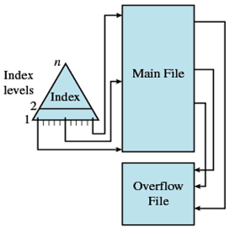
Indexed Sequential File
Index provides a lookup capability to quickly reach the vicinity of the desired record
Index contains key field and a pointer to the main file
Indexed is searched to find highest key value that is equal to or precedes the desired key value
Search continues in the main file at the location indicated by the pointer

Slide 24
Indexed Sequential File
Comparison of sequential and indexed sequential
Example: a file contains 1 million records
On average 500,000 accesses are required to find a record in a sequential file
If an index contains 1000 entries, it will take on average 500 accesses to find the key, followed by 500 accesses in the main file. Now on average it is 1000 accesses

Slide 25
Indexed Sequential File
New records are added to an overflow file
Record in main file that precedes it is updated to contain a pointer to the new record
The overflow is merged with the main file during a batch update
Multiple level of indexing can be set up to increase efficiency

Slide 26
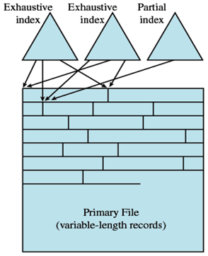
Indexed File
Uses multiple indexes for different key fields
May contain an exhaustive index that contains one entry for every record in the main file
May contain a partial index

Slide 27
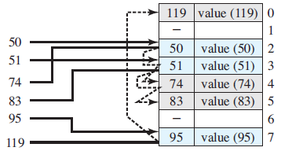
Direct or Hash File
Key field required for each record
No concept of sequential ordering
It make use of hashing on key value

